Slide 1
Jen Rohda, RN
Certified Specialist in Poison Information

Slide 2
Caffeine AND Energy Drinks

Slide 3
Why are bees so attracted to energy drinks?
Because they catch a buzz

Slide 4
Caffeine and high school students often have a complex relationship. Many teenagers turn to caffeine to help them stay awake and alert during long hours of studying, early morning classes, or extracurricular activities. However, it's important to note that excessive caffeine consumption can have negative effects on sleep patterns, anxiety levels, and overall health, especially in young people.

Slide 5
What is caffeine?
Plant derived methylxanthine
Methylxanthines have vasodilatory, anti-inflammatory and immunomodulatory actions.
Commonly used for stimulant effects
Marketed as “enhanced energy, concentration, and athletic performance.”
Adenosine antagonist
Causes catecholamine release ~> resulting in CNS excitation, peripheral vasodilation, and myocardial stimulation

Slide 6
History of caffeine
Caffeine is the most widely used psychoactive substance in the world
It is found in common foods and beverages
Available in prescription and OTC medications. Caffeine may also be found in products marketed as “stay alert,” “stay awake,” “diet pills,” or “energy pills.”
Caffeine may be used for the treatment of idiopathic apnea of prematurity, acute respiratory depression, migraine, pain, or fatigue.
It is often found in combination with analgesics, butalbital, opioids, adrenergic agonists, or ergot alkaloids

Slide 7
How much caffeine can I have?
Adolescents 12-18 years old should take in no more than 100 mg of caffeine daily. This is about equal to:
1 cup of coffee (6-8 ounces =1 cup)
1-2 cups of tea
2-3 cans of soda
Energy drinks pose a particularly high risk. Companies are not required to list caffeine amounts, and even if they do, nutrition labels can be confusing. It is often unclear just how much caffeine is in the drink. This makes it even more likely that a teen may take in too much caffeine and suffer negative side effects.
Healthy adults should have no more than 400mg of caffeine daily

Slide 8
How many energy drinks can you name?
Some of the more well-known ones are
Red Bull
Monster Energy
Rockstar
Rip It
There are thousands of energy drinks available around the world

Slide 9
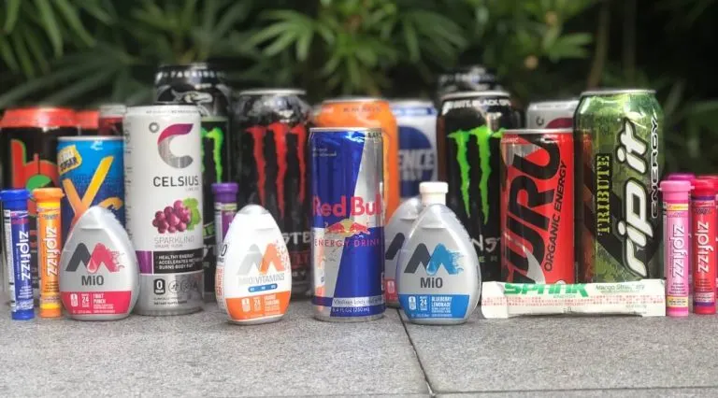

Slide 11
SOME COMMON ADDITIVES THAT CONTAIN CAFFEINE OR CONTRIBUTE TO ITS EFFECTS:
CHOLINE
GINSENG
GLUCURONOLACTONE
GUARANA
INOSOL
KOLA NUT
MALIC ACID
MALTODEXTRIN
NIACIN
PANTOTHENIC ACID
TAURINE
THEANINE
TYROSINE
YERBA MATE

Slide 12
Other Caffeine Sources:
Caffeine can be found in many over-the-counter preparations
appetite suppressants
stimulants
exercise supplements
decongestants
bronchodilators
mental stimulants

Slide 13
Dry Scooping
Dry Scooping – dangerous trend in consumption of pre-work out powders
Dry scooping has become popular thanks to social media trends.
Pre-workout powders are a caffeine and stimulant based supplement, used before a workout to provide more “energy” for an enhanced work-out. They are intended to be added to a predetermined amount of water as directed on the label. It is supposed to be diluted to help the body absorb the supplements at a moderate pace.
Dry scooping increases the absorption rate and flood the body with caffeine.

Slide 14
Pre-workout supplements are poorly regulated in the United States and may contain toxic ingredients that are not on the label. Since the exact composition of these products may be unclear, it is possible that the toxicity of some of the unknown ingredients can be worsened by dry scooping.

Slide 15
THIS REALLY HAPPENED
A 20-year-old woman experienced chest pain, coughing, and sweating after dry scooping a pre-workout powder. She was taken to a hospital, where doctors diagnosed her with a mild heart attack. The cause of the heart attack was believed to be the caffeine which was present in the pre-workout powder she ingested. She was admitted to a hospital and treated with blood thinners. Fortunately, she made a full recovery.

Slide 16
Unwanted Side effects of caffeine
IRRITABILITY
JITTERINESS
RESTLESSNESS
TACHYCARDIA
REDUCED INTAKE OF FOOD/FLUIDS
INCREASED URINE OUTPUT
FLUSHING OF THE SKIN
HYPERGLYCEMIA

Slide 17
Caffeine Toxicity or Overdose
Toxic ingestion: May be due to limited or unclear dosing instructions on packaging amounts. Particularly on powdered/anhydrous caffeine products
Rapid and near complete (up to 90%) absorption
Peak plasma concentration ~40min
Severe toxicity = catecholamine release resulting in sympathetic overdrive, seizures, and tachydysrhythmias

Slide 18
S/S of toxicity
Cardiovascular: angina, atrial fibrillation, atrial flutter, bradycardia, cardiac arrest (severe intoxication), cardiac arrhythmias, chest pain, flushing, hypertension, hypotension (paradoxical), myocardial ischemia (severe intoxication), palpitations, premature ventricular contractions (PVC), QRS prolongation, sinus tachycardia, supraventricular tachycardia, vasodilation, ventricular fibrillation, wide pulse pressure
Central nervous system: agitation, anxiety, delirium, diaphoresis, fever, hallucinations, headache, insomnia, intracerebral hemorrhage (severe intoxication), irritability, nervousness, psychosis, restlessness, seizures (severe intoxication), visual hallucinations
Endocrine & metabolic: anion gap (severe intoxication), hypercholesterolemia, hyperglycemia, hypocalcemia, hypokalemia, hypomagnesemia, hyponatremia, hypophosphatemia, increased lactate, metabolic acidosis (severe intoxication)
Gastrointestinal: abdominal cramps, abdominal pain, decreased esophageal sphincter tone, erosive esophagitis, esophageal reflux, gastritis, nausea, vomiting
Hematologic: leukocytosis
Neuromuscular & skeletal: fasciculations, rhabdomyolysis (severe intoxication), tremor
Ocular: miosis
Otic: tinnitus
Renal: diuresis, ketonuria, myoglobinuria, renal failure
Respiratory: hyperventilation, respiratory alkalosis, respiratory arrest (severe intoxication)

Slide 19
A student goes to the school nurse, now what?
If they are complaining of mild symptoms including
Not wanting to eat or drink
Headache
Tremor
Restlessness
Nausea or vomiting
Chest pounding
Do this
Check vital signs
Check blood glucose level (if able)
Get something in their belly like milk (whatever milk they use; cow, almond, oat) and a snack. This will help to minimize GI upset.
Keep them hydrated. Caffeine is a diuretic; some symptoms may be related to excessive urination.
Let them rest, lay down for a while. Up to 2 hours as able.
No strenuous activities until feeling better. No more caffeine for the day and education.
Peak 30-2hr
Half-life up to 16 hrs

Slide 20
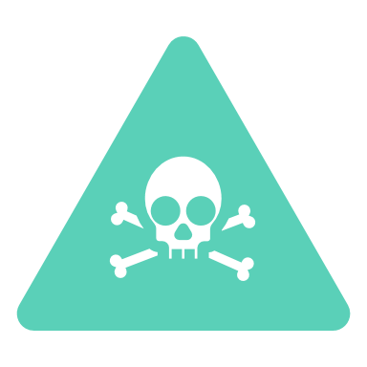
Call the Poison Center at
1-800-222-1222 and the Specialist in Poison Information can assist with figuring out how much is too much and if more than observation is needed. The Specialist will do a weight-based calculation. depending on the mg/kg amount of the ingestion, the specialist will decide if that person should be seen in a health care facility.

Slide 21
Some high school students may rely on caffeinated beverages like coffee, energy drinks, or soda to help them through the day, but it's essential for them to consume these beverages in moderation. Too much caffeine can be counterproductive for academic performance.

Slide 22
Educating high school students about the potential risks and benefits of caffeine consumption is crucial. Encouraging healthy sleep habits, time management skills, and stress management techniques can also help reduce the need for caffeine as a crutch. Additionally, promoting alternatives like staying hydrated, eating nutritious foods, and taking short breaks for physical activity can contribute to sustained energy levels without relying solely on caffeine.

Slide 23
I PUT REDBULL IN MY COFFEE THIS MORNING INSTEAD OF WATER
AND NOW I CAN SEE NOISES

Slide 24
THANK YOU!
Nebraska Poison Center Educator
Jen Rohda RN, CSPI
If you have any questions about poisons or think you or someone you know have been poisoned call 1-800-222-1222
Registered Nurses and Pharmacists are available 24/7/365

Slide 25
References
https://online-lexi-com.eu1.proxy.openathens.net/lco/action/doc/retrieve/docid/patch_f/6497?cesid=6McRBdoXbQw&searchUrl=%2Flco%2Faction%2Fsearch%3Fq%3Dcaffeine%26t%3Dname%26acs%3Dtrue%26acq%3DCaffeine
https://online-lexi-com.eu1.proxy.openathens.net/lco/action/doc/retrieve/docid/lexier/1304741?cesid=4fzLwlCNyNu&searchUrl=%2Flco%2Faction%2Fsearch%3Fq%3DCaffeine%26t%3Dname%26acs%3Dfalse%26acq%3DCaffeine#sas
http://gptoxapp01/micromedex2/librian/cs
poisoning & drug overdose seventh edition. ann arens, md and neal l. benowitz, md pg 169-172
https://www.quora.com/How-much-caffeine-does-a-12-Fl-Oz-Diet-Dr-Pepper-have
https://www.tasteofhome.com/collection/caffeinated-drinks/
https://www.reddit.com/r/safe_food/comments/15p53vp/guide_to_energy_drink_contents/
https://www.changelabsolutions.org/sites/default/files/EnergyDrinkMini-CaseStudies_2012_1.pdf
https://www.nccih.nih.gov/health/energy-drinks
https://www.poison.org/articles/dry-scooping-can-be-life-threatening
https://www.mayoclinichealthsystem.org/hometown-health/speaking-of-health/what-are-hidden-sources-of-caffeine
https://schoolnutrition.extension.illinois.edu

